Slide 1
Education in Estonia
Marika Ristmäe, Ülle Valgi
Italy, 2017

Slide 2
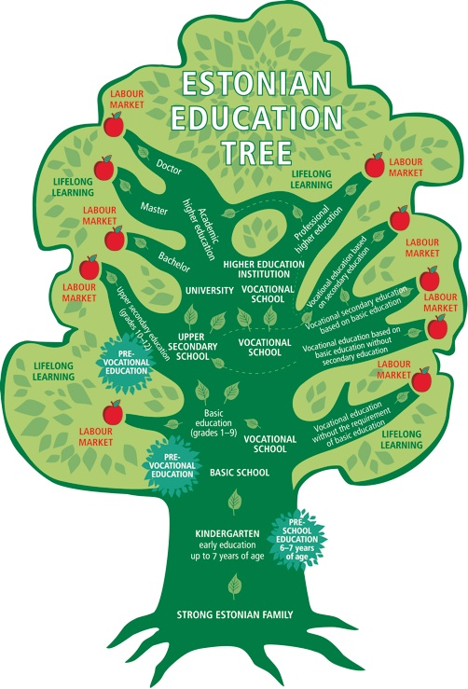
In Estonia the provision of general education at all levels of education is carried out on the basis of common national curricula.
Schools prepare their curricula on the basis of these national curricula.
The duration of the study period is at least 175 school days (35 weeks), and there are four school holiday periods.

Slide 3
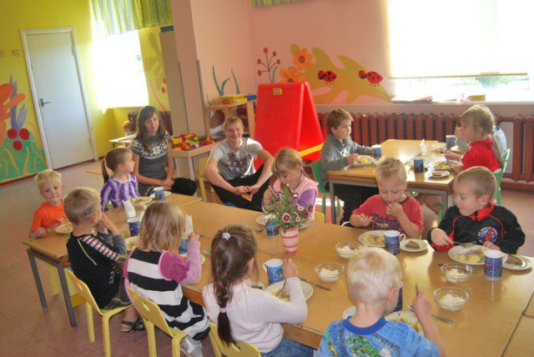
Preschool education
Before starting school children usually attend preschool child care institutions.
Children who turn 7 years of age by 1 October of the current year are obliged to attend school.

Slide 4
Basic education
divided into three stages of study:
Stage 1 – grades 1–3 (replacement tests)
Stage 2 – grades 4–6 (replacement tests)
Stage 3 – grades 7–9 (three graduation examinations)
There are several options for continuing one’s education after graduating from basic school:
a general secondary education in an upper secondary school,
a secondary vocational education
simply a vocation in a vocational educational institution.
The compulsory schooling obligation applies to children until they acquire basic education or turn 17 years of age.
Upper secondary education grades 10-12 (five graduation examinations, at least three of which must be state examinations)

Slide 5
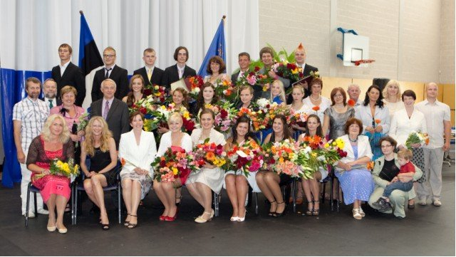
After secondary education, pupils have three options for further studies:
vocational educational institution
professional higher education institution, colleges of universities
university –Bachelor’s degree (3 years) -> Master’s degree (2 years) -> doctoral degree (3 to 4 years).

Slide 6
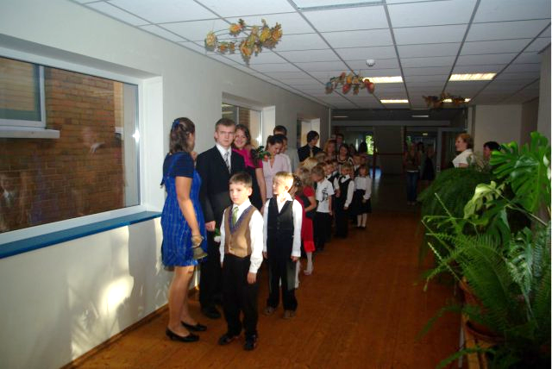
Developments in education policy
The new Basic Schools and Upper Secondary Schools Act which will, among other things, establish the separation of the basic school and upper secondary school level in municipal schools;
the new updated national curriculum since 2014 ;

Slide 7
Career planning in Häädemeeste Secondary School
174 - students (10.11.2016)
28 - teachers (10.11.2016)

Slide 8
Häädemeeste Secondary School helps students from the age 14 to 19 (year 8 to year 12) to start their career planning
Lecturers come to school and give lectures on different topics concerning future work-life,
excursions to different enterprises take place,
students take tests and analyse themselves to become aware of their interests, capabilities and skills, which enable making definite plans for their career.
Students are taken to the Vocational Centre of Pärnu County (VCPC) to see what specialities can be taught there.

Slide 9
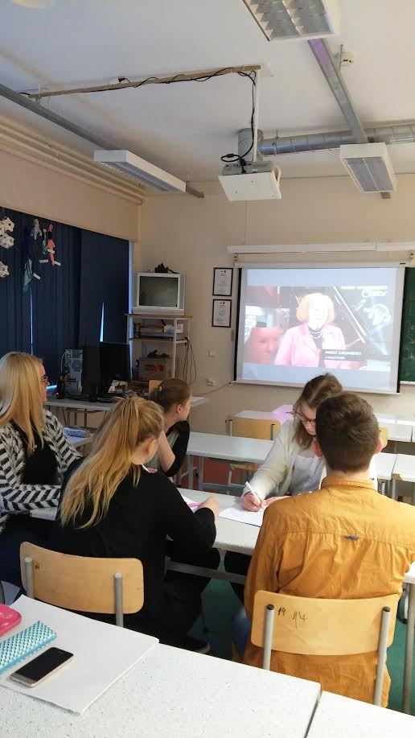
In Häädemeeste Secondary School students can choose between optional subjects depending on human resources (teachers we have) and students interests.
They can choose between
applied:
biology,
architecture,
Spanish while in upper
secondary school (year 10-12).

Slide 10
Every year in November students from upper secondary school take part in Job-shadowing Day. Later prepare a presentation to give an overview what they learnt about certain jobs.
They get familiar with different professions and also with educational and vocational possibilities.

Slide 11
Häädemeeste Secondary School works closely together with local institutions. As the school is in the area of pure nature, we are going to do a lot of cooperation between local enterprises like
State Forest Management Centre,
Tourism enterprises,
Bird Watching Centre;
Study the courses connected to the eco production (rakendusbioloogia).

Slide 12
In the future there is a plan to include into school curriculum an optional course "Career Education" for our school, which involves
the knowledge of the history of the local enterprises, about the natural sources. The area has been created jobs according to the usage of natural sources throughout the centuries - clay bricks for the ovens were made in this region already since 1890s; sand, gravel, bog peat; forest and shipbuilding;
the sea and fishing; farming; the beach, pure nature and tourism.
Co-operation with local enterprises and/ or institutions will be very important in this course.
self-analyses
job-shadowing

Slide 13
Thank you!

